Slide 1
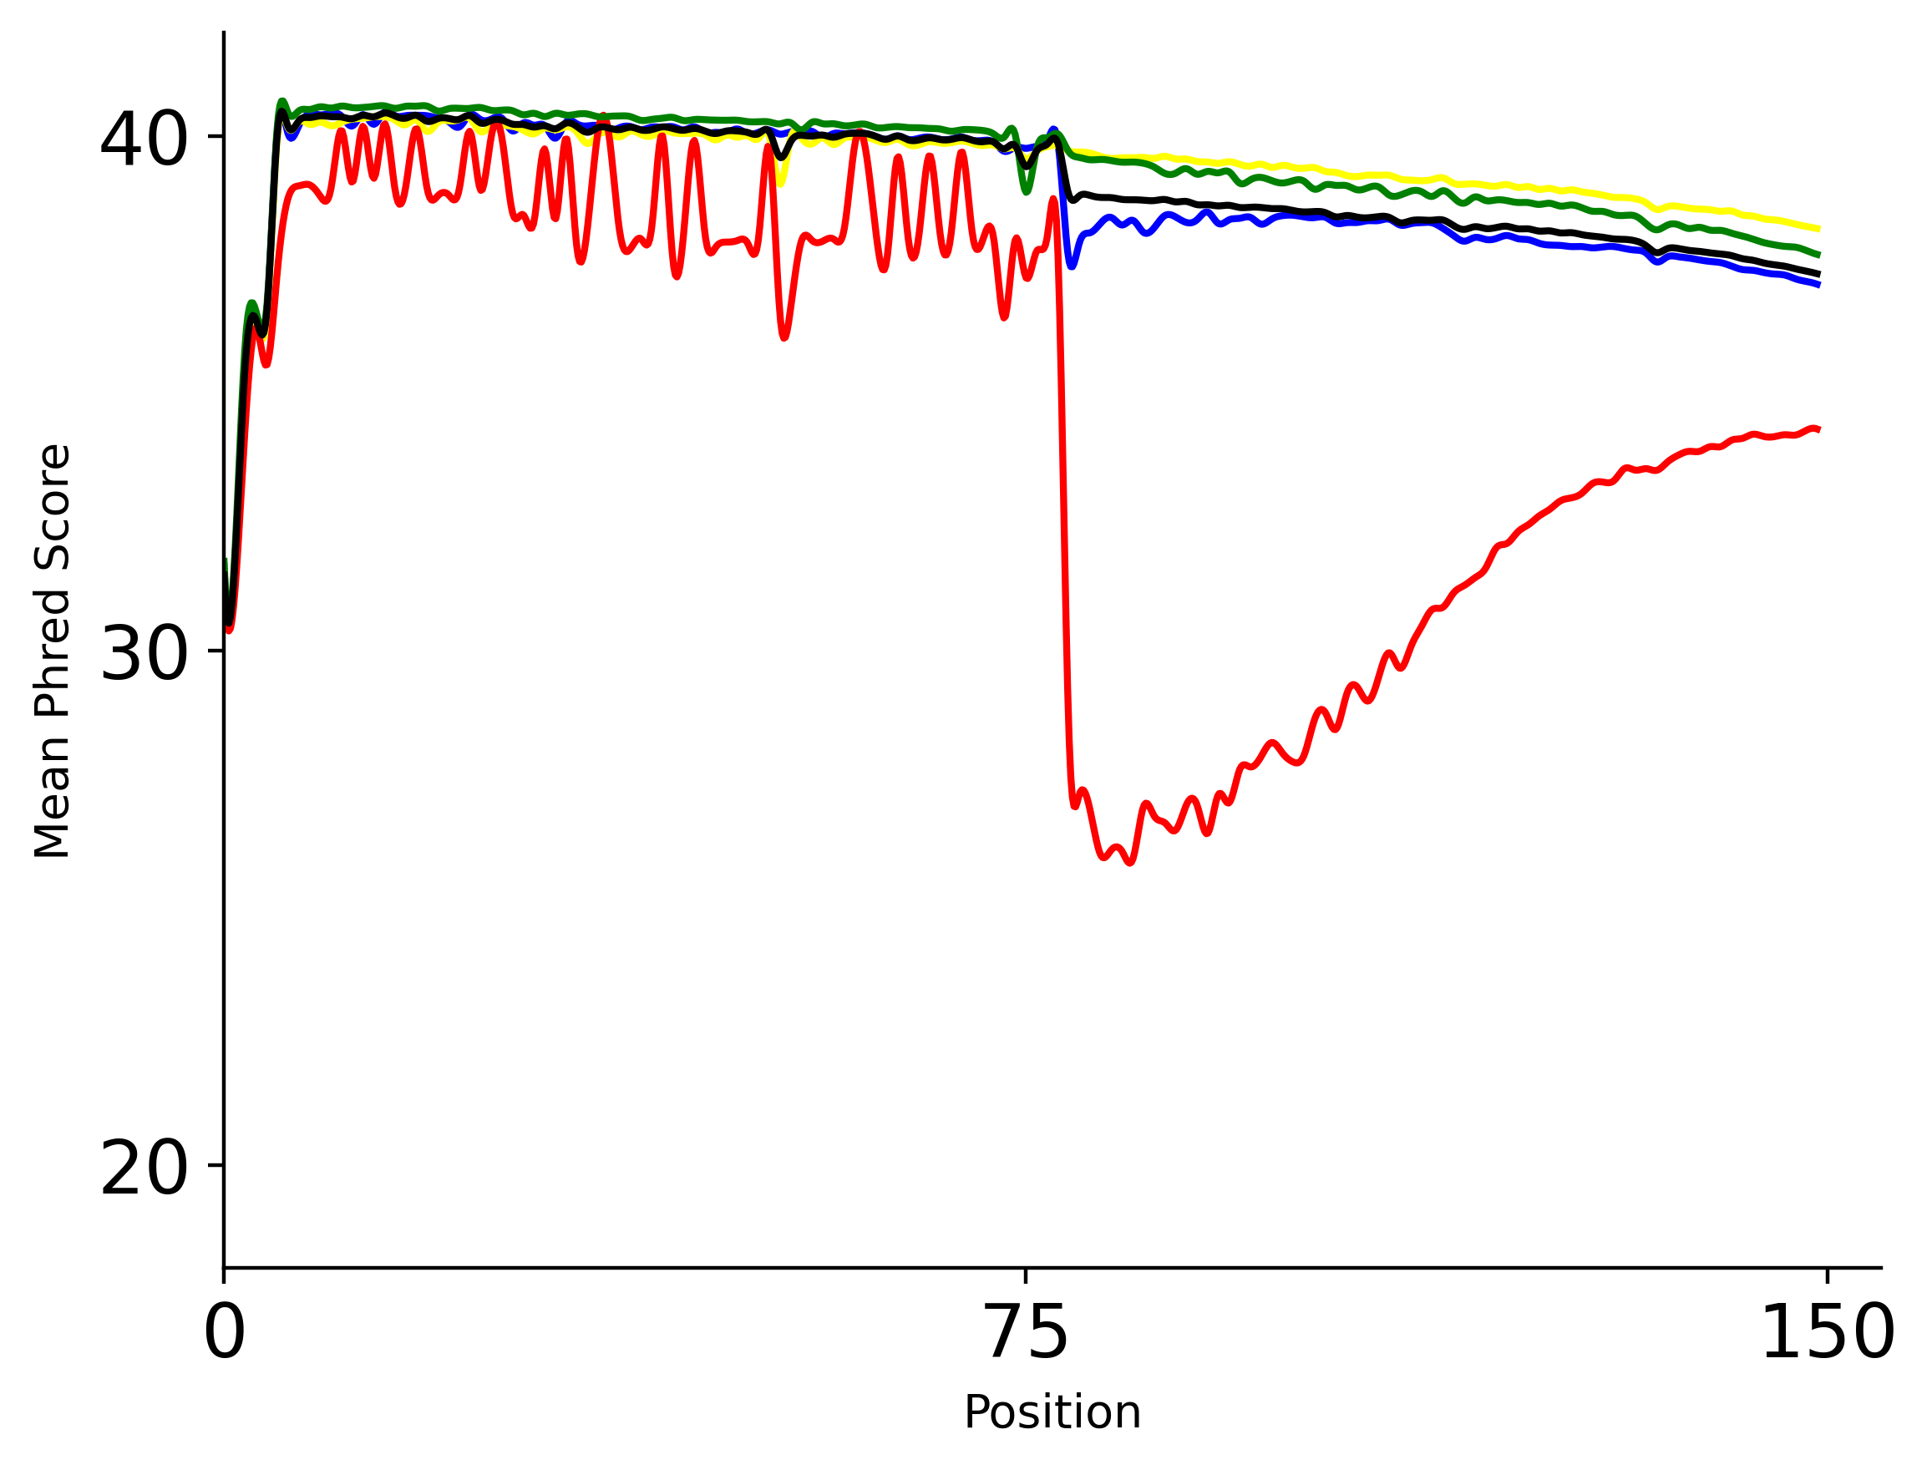
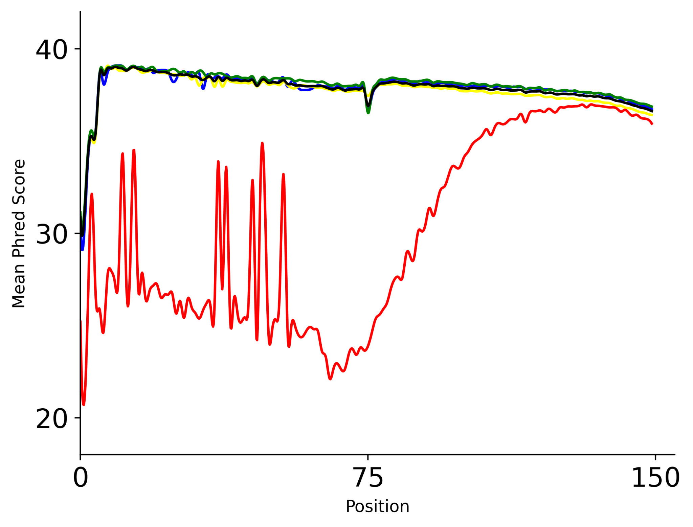
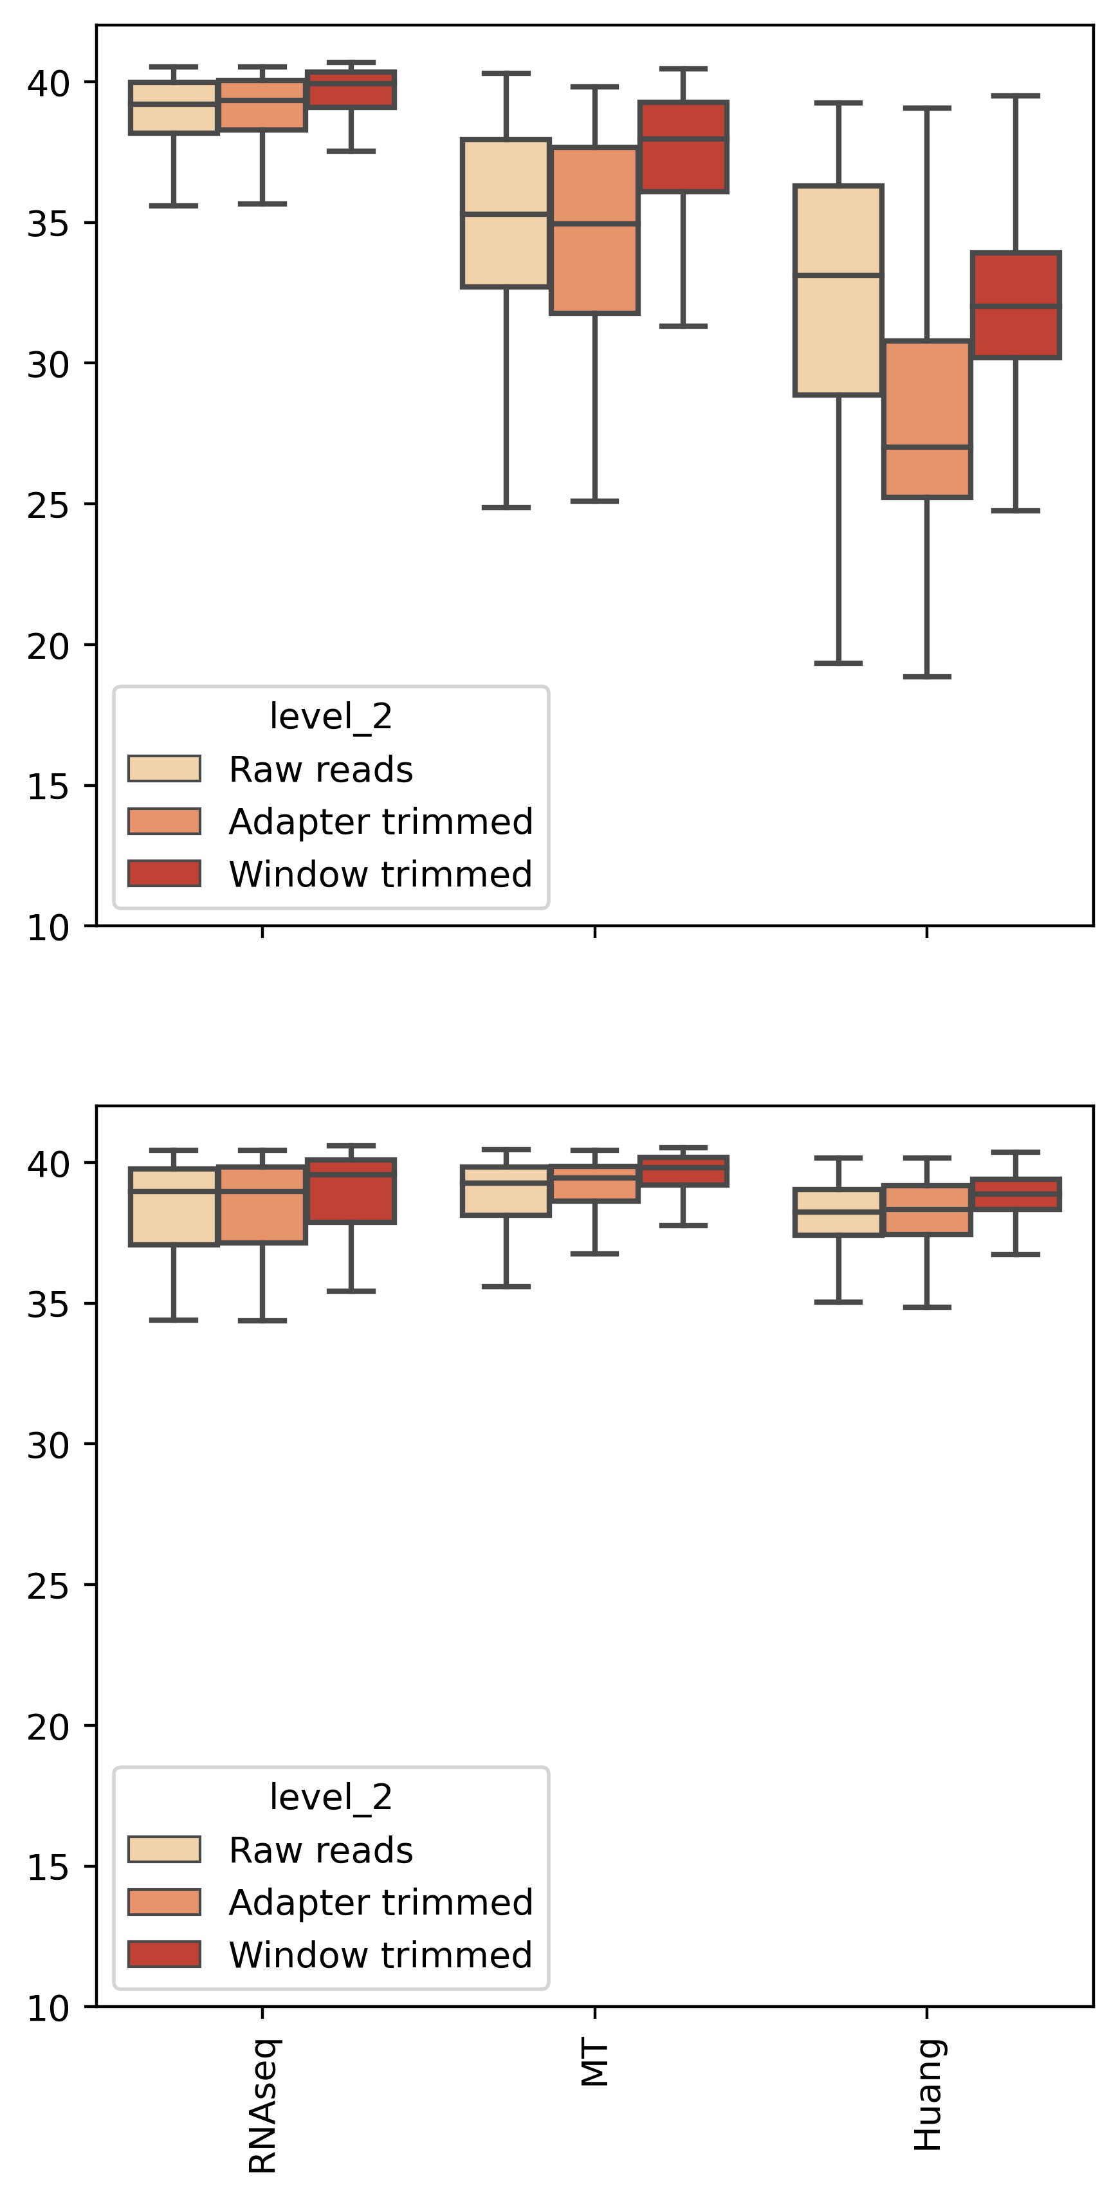

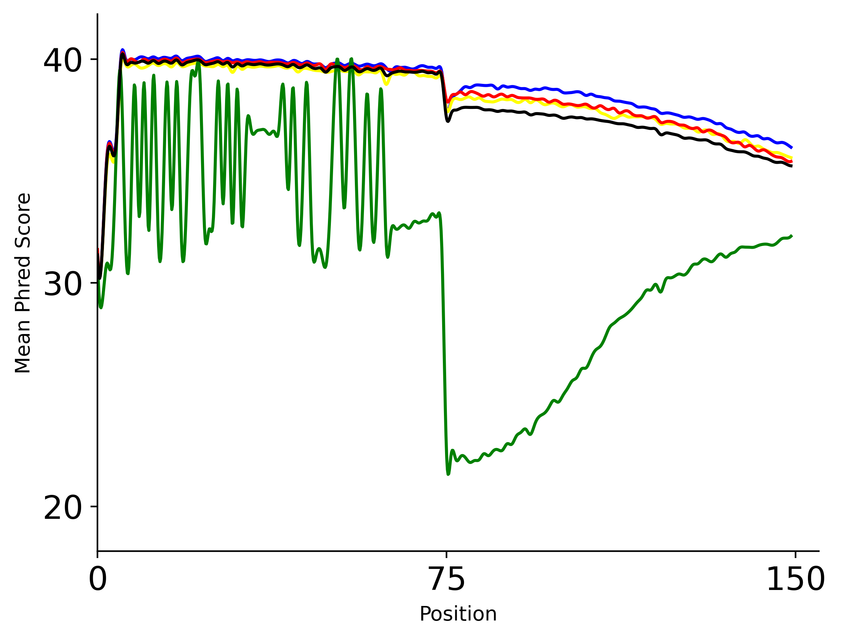
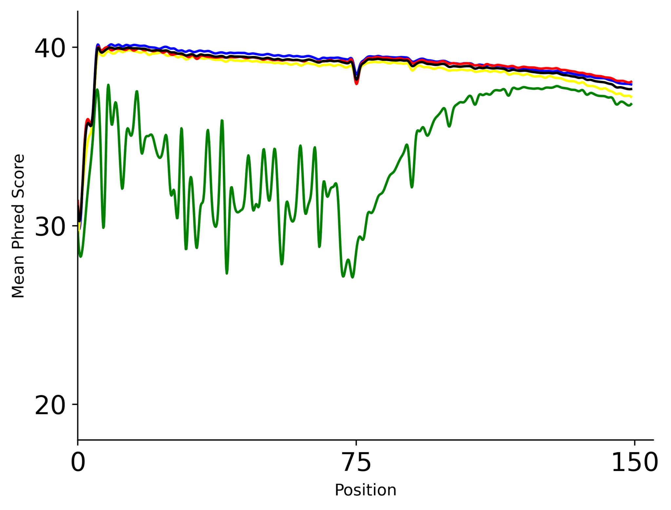
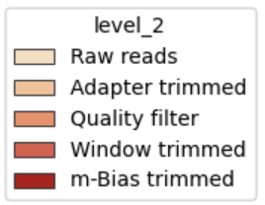
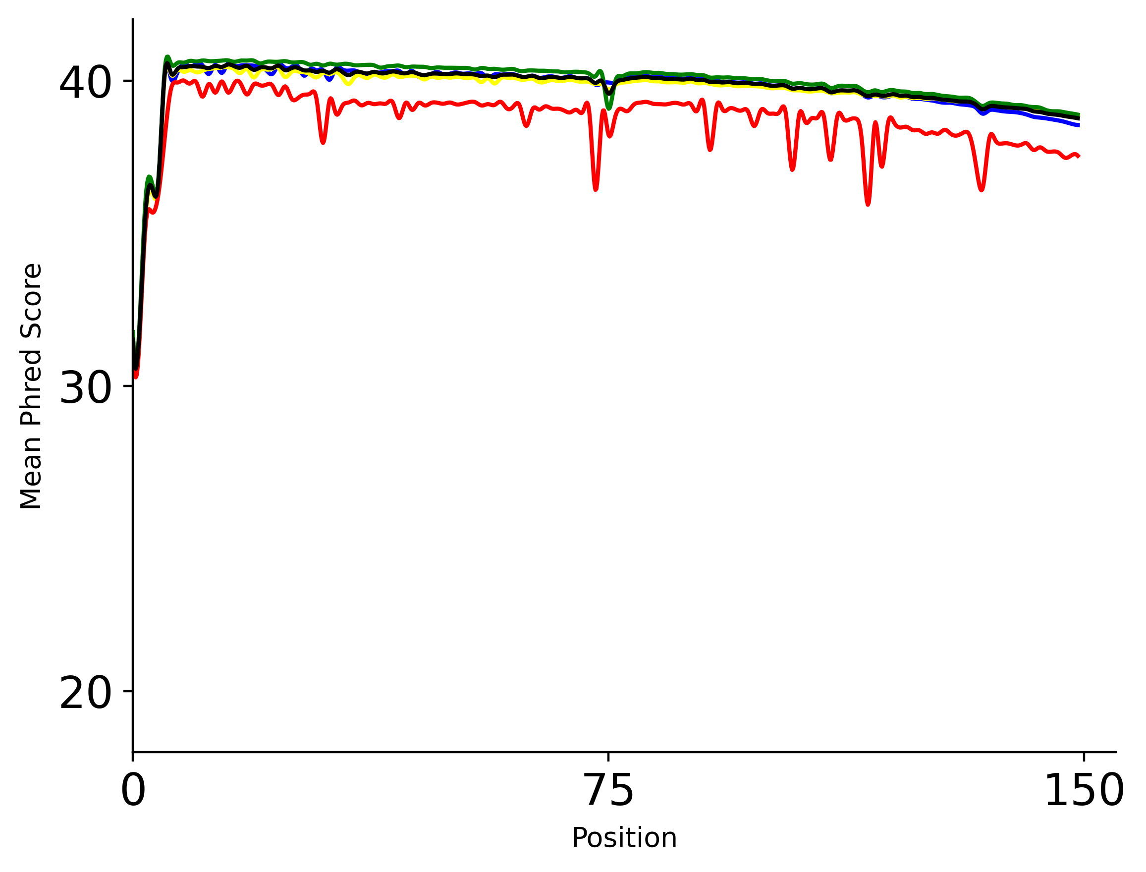
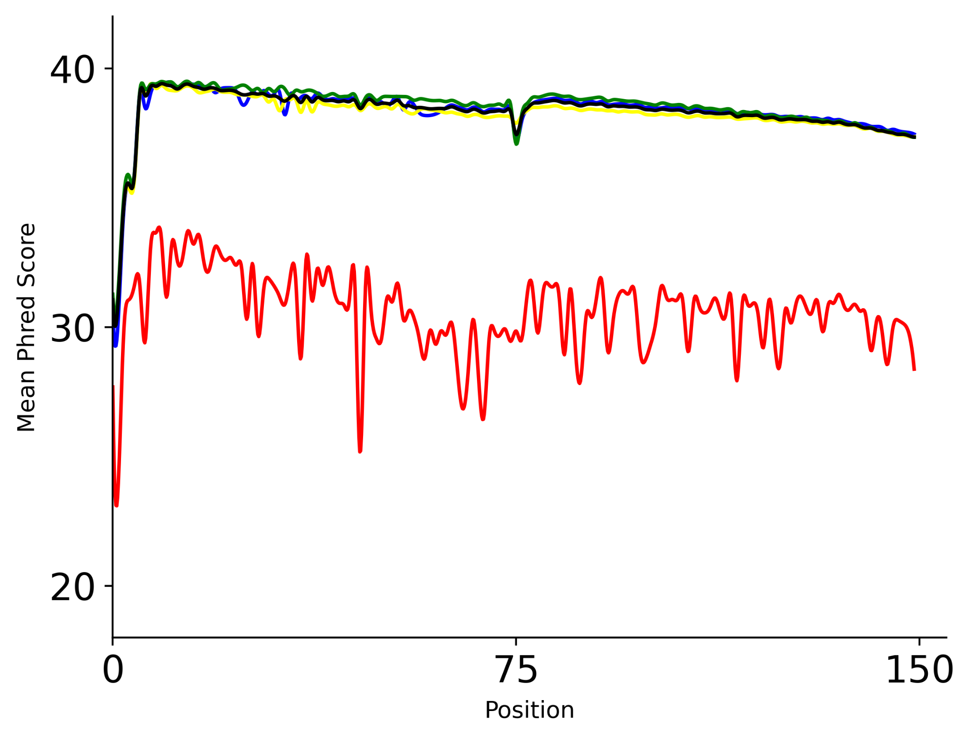
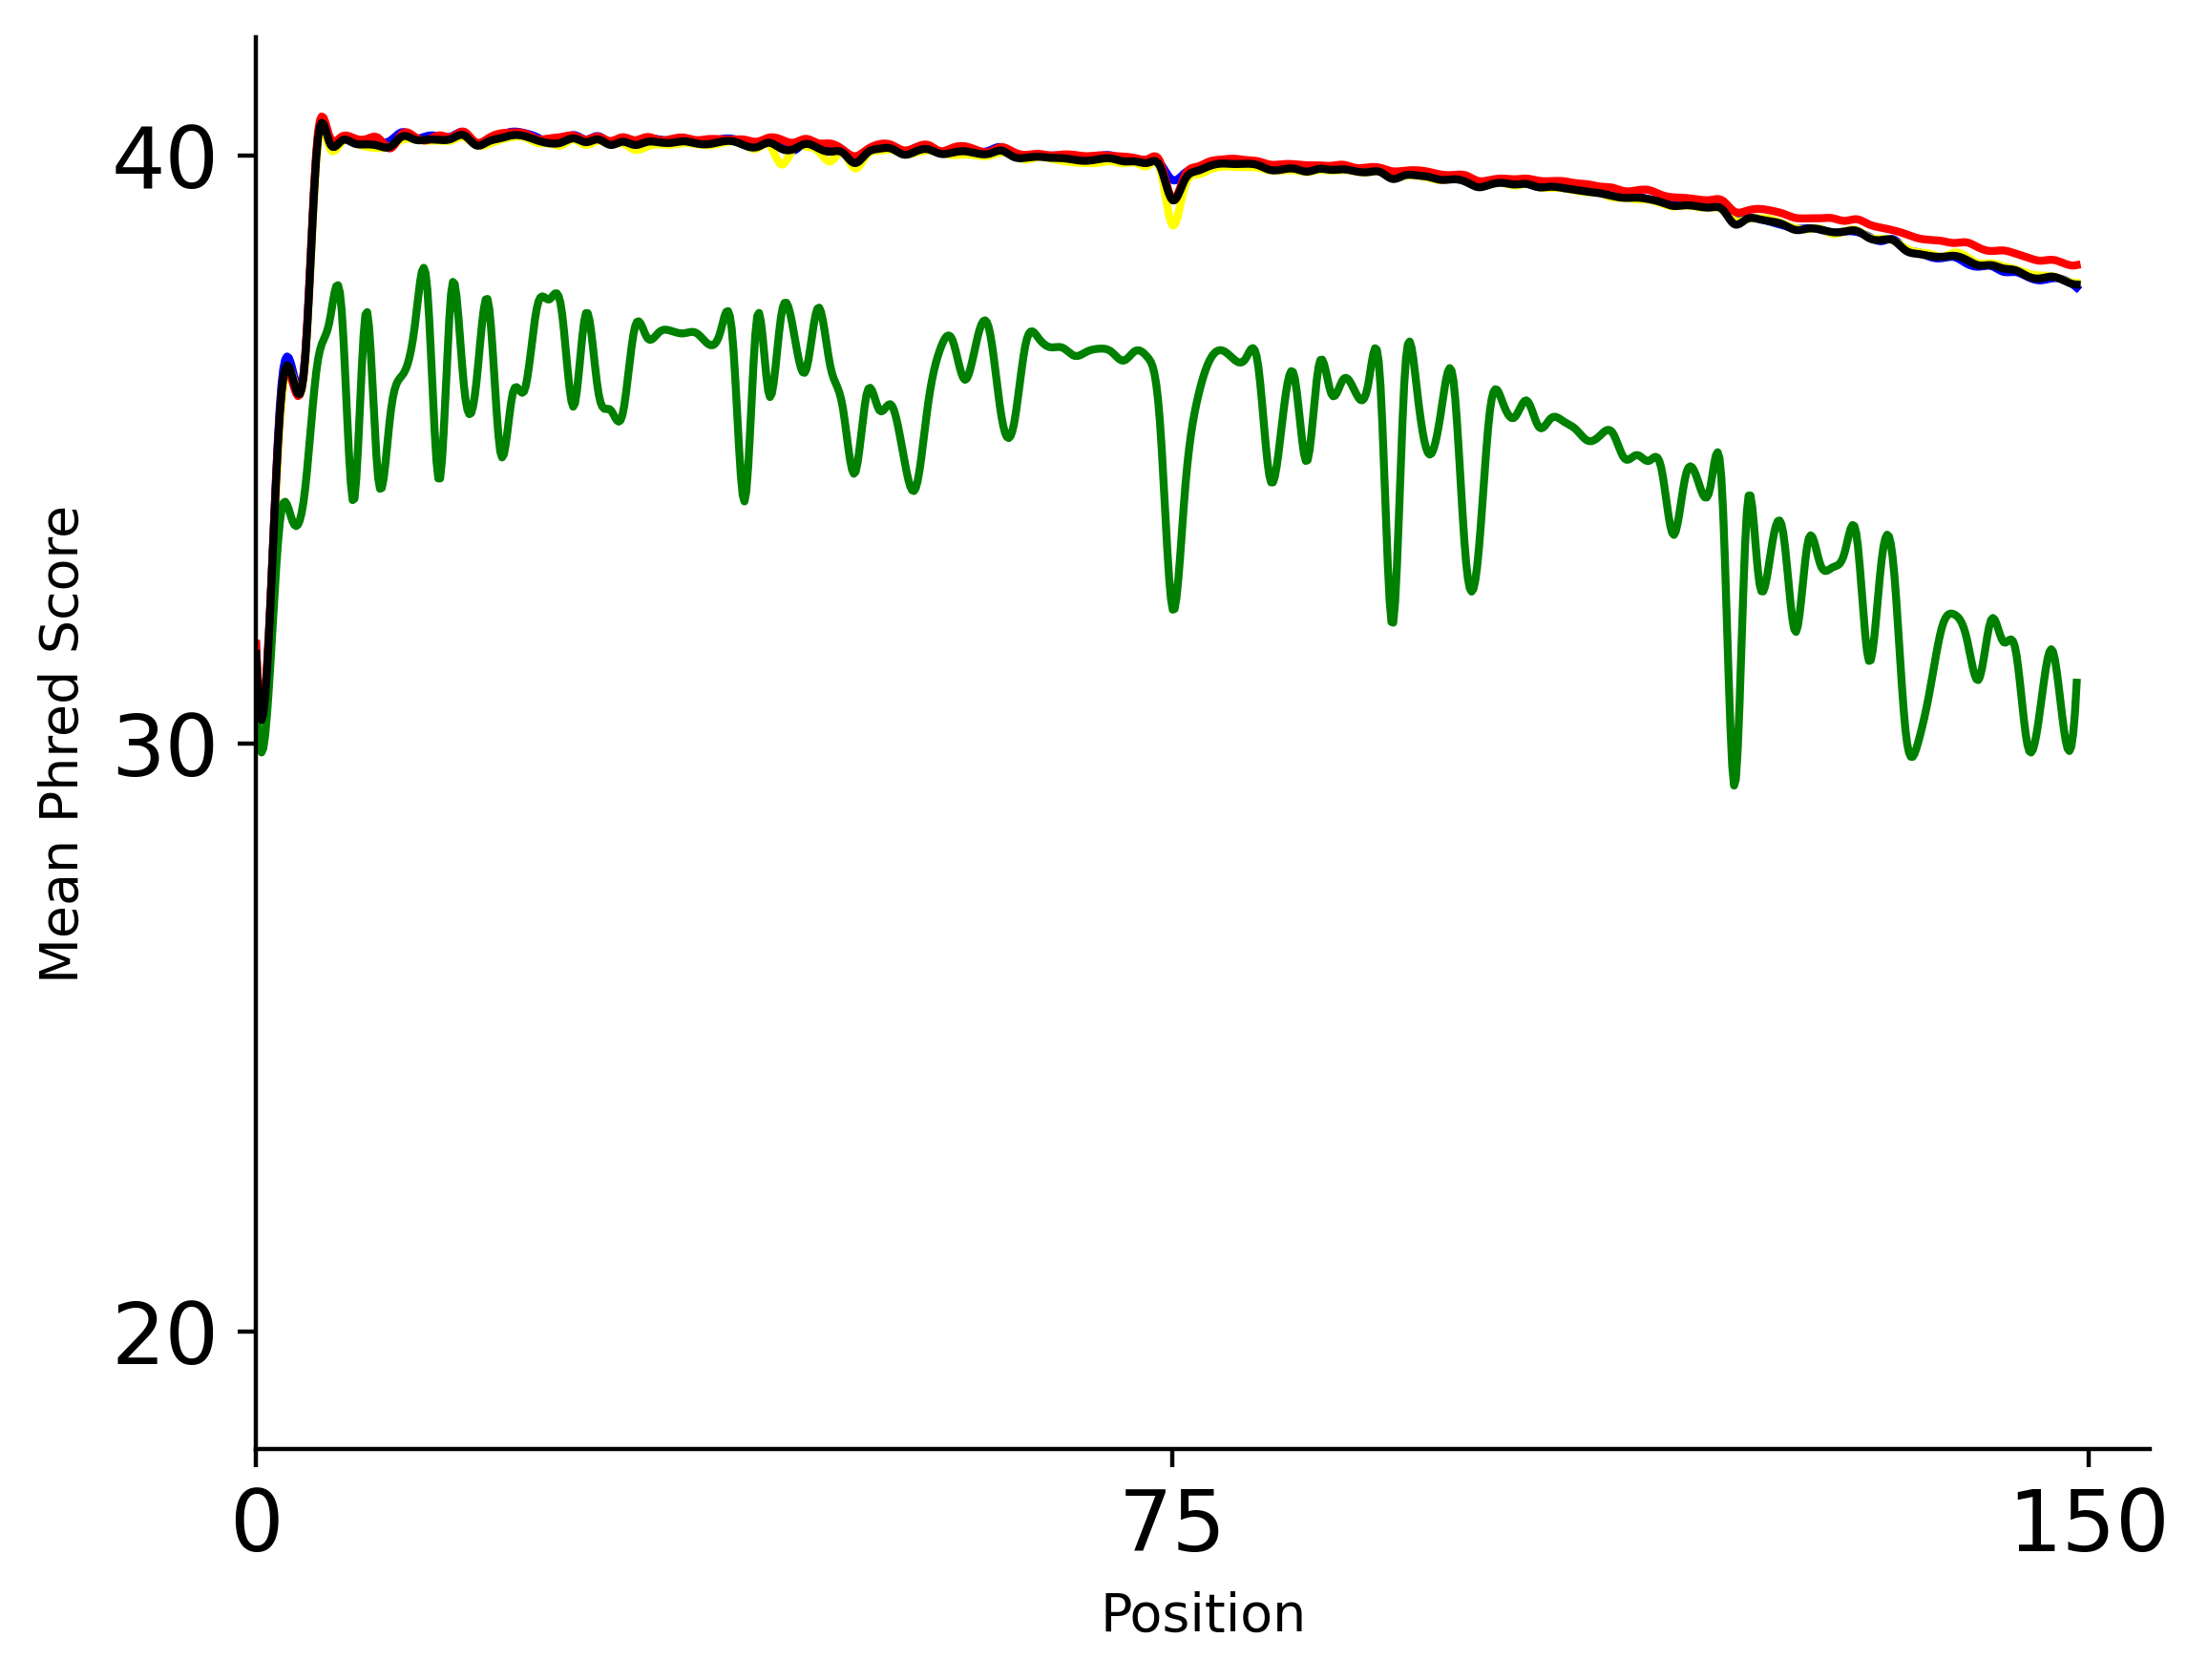
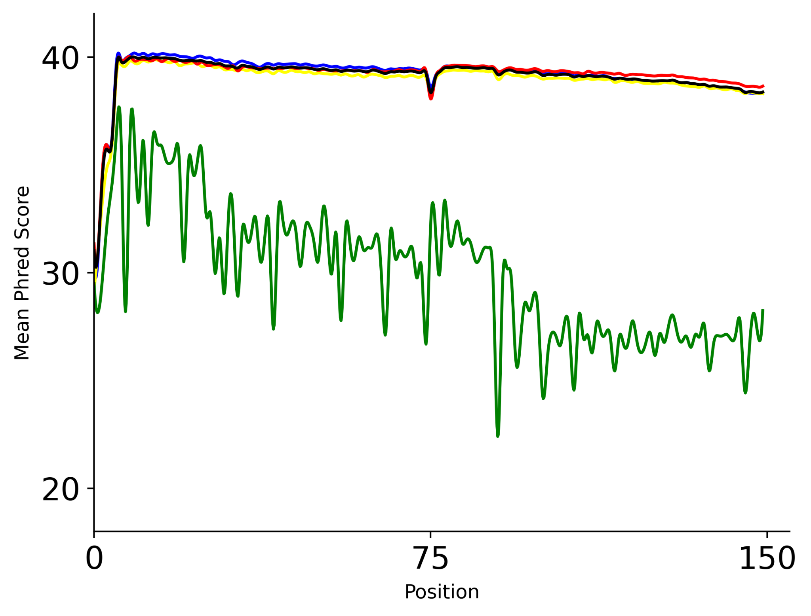
A
MT RNA BS-seq (MT-A)
Huang Replicate 2
C
p-m⁵C sites
40
30
20
Read 1 – Raw
Read 1 – Raw
Phred Score
40
30
20
Raw reads
Sequence trim
Quality filter
Read 2 - Raw
Read 2 - Raw
0 | 75 | 150
0 | 75 | 150
Phred Score
All bases
Position (bp)
B
MT RNA BS-seq (MT-A)
Huang Replicate 2
40
30
20
Read 1 – Clean
Read 1 – Clean
Phred Score
40
30
20
Read 2 - Clean
Read 2 - Clean
MT RNA-seq
MT RNA BS-seq
Huang
0 | 75 | 150
0 | 75 | 150
Position (bp)
Figure 2. Quality score analysis of p-m⁵C bases. (A-B) Mean Phred score per base sequence of adenosine (blue), thymine (yellow), guanine (green), and cytosine (red) in MT-A replicate 1 and Huang replicate 2 datasets before (A) and after (B) all cleaning steps. (C) Mean base-level Phred scores at each step of the sequence cleaning pipeline (shades of red). p–m⁵C sites are considered to be “Cs” in Read 1 and “Gs” in Read 2. p-m⁵C bases are depicted in the top figure, and the average of all nucleotides are represented in the bottom figure.

